Slide 1
Chapter 7 Security and Crash Recovery
1. Security and integrity violations
2. Access control and authorization, views
3. Failure classification
4. Recovery and Atomicity- log records, database modification, concurrency control and recovery, transaction commit, Redo and Undo Transactions using Log, Check Points,
5. Recovery Algorithm Using Log Records- Transaction Rollback, Recovery after a System Crash, Optimizing Commit Processing

Slide 2
Security

Slide 3
Security
7.1 Database Security
7.2 Need of Security
7.3 Security and integrity violation
7.4 Access control
7.7 Authorization
7.7 Security and Views
7.7 Encryption and Decryption

Slide 4
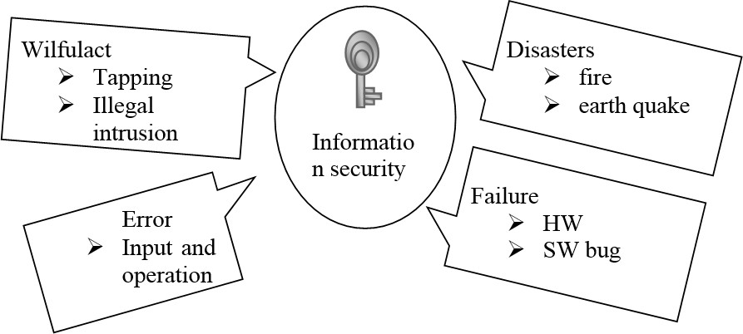
7.1 Database Security
Database security means protecting information and information systems from unauthorized access, use, disclosure, disruption, modification, or destruction.
Security of data against intentional or unintentional threats.

Slide 5
7.1 Database Security
Designing and implementing a secure database involves achieving the following objectives:
Confidentiality: Prevent the disclosure or leak of sensitive information from unauthorized people, resources, and processes.
Integrity: The protection of system information or processes from intentional or accidental modification.
Availability: The assurance that systems and data are accessible by authorized users when needed.
Authentication: Making sure the data is from where it is supposed to be from.

Slide 6

7.1 Database Security : Security attacks
Interruption
This is an attack on availability.
Example: Cutting of a communication line or the disabling of the file management system.

Slide 7
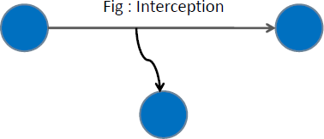
7.1 Database Security : Security attacks
Interception
This is an attack on confidentiality.
Example: Wiretapping to capture data in a network and unauthorized copying of files or programs.

Slide 8
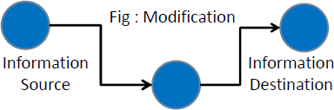
7.1 Database Security : Security attacks
Modification
This is an attack on integrity.
Example: Changing values in a data or modifying the content of message being transmitted.

Slide 9

7.1 Database Security : Security attacks
Fabrication
This is an attack on authenticity.
Example: Insertion of fake messages in a network.

Slide 10
7.2 Need of Database Security
Security considerations will apply not only to the data stored in an organization's database:
A breach of security may impact other aspects of the system, which may ultimately affect the database structure.
As a result, database security encompasses hardware parts, software parts, human resources, and data.

Slide 11
7.2 Need of Database Security
Security is an important concern in database management because the information stored in a database is a very valuable and, at times, quite sensitive commodity.
As a result, data in a database management system must be protected from abuse and illegal access and updates.
Although most security breaches are caused by hackers, in reality, insiders account for 80% of data loss.
The extent to which an incident, such as a data breach, can harm our company is determined by several factors.

Slide 12
7.2 Need of Database Security
How much harm a data breach inflicts on your enterprise depends on a number of consequences or factors:
Compromised intellectual property: Your intellectual property—trade secrets, inventions, proprietary practices—may be critical to your ability to maintain a competitive advantage in your market. If that intellectual property is stolen or exposed, your competitive advantage may be difficult or impossible to maintain or recover.

Slide 13
7.2 Need of Database Security
Damage to brand reputation: Customers or partners may be unwilling to buy your products or services (or do business with your company) if they don’t feel they can trust you to protect your data or theirs.
Business continuity (or lack thereof): Some business cannot continue to operate until a breach is resolved.
Costs of repairing breaches and notifying customers: In addition to the cost of communicating a breach to customer, a breached organization must pay for forensic and investigative activities, crisis management, triage, repair of the affected systems, and more.

Slide 14
7.3 Control Methods of Database Security
Security of database is controlled by DBA.
Database Security and the DBA
The database administrator (DBA) is the central authority for managing a database system.
The DBA’s responsibilities include granting privileges to users who need to use the system and classifying users and data in accordance with the policy of the organization.
The DBA has a DBA account in the DBMS, sometimes called a system or superuser account, which provides powerful capabilities that are not made available to regular database accounts and users.

Slide 15
7.3 Control Methods of Database Security
Database Security and the DBA
DBA- privileged commands include commands for granting and revoking privileges to individual accounts, users, or user groups and for performing the following types of actions:
Account creation. This action creates a new account and password for a user or a group of users to enable access to the DBMS.
Privilege granting. This action permits the DBA to grant certain privileges to certain accounts.
Privilege revocation. This action permits the DBA to revoke (cancel) certain privileges that were previously given to certain accounts.
Security level assignment. This action consists of assigning user accounts to the appropriate security clearance level.

Slide 16
7.3 Control Methods of Database Security
Following are the control measures :
Access Control
Authentication
Authorization
Integrity Control
Views
Encryption
Backup and Recovery

Slide 17
7.3 Control Methods of Database Security
Access Control
Database access control is a method of allowing access to company’s sensitive data only to those people (database users) who are allowed to access such data and to restrict access to unauthorized persons.
It includes two main components: authentication and authorization.

Slide 18
7.3 Control Methods of Database Security
Access Control
Preventing unauthorized persons from accessing the system itself, either to obtain information or to make malicious changes in a portion of the database.
The security mechanism of a DBMS must include provisions for restricting access to the database system as a whole.
This function, called access control, is handled by creating user accounts and passwords to control the login process by the DBMS.

Slide 19
7.3 Control Methods of Database Security
Access Control
In practice, there are two major approaches to data security.
Discretionary control: In this type of security, a user will have different access rights, also known as privileges on individual items. Obviously, there are various limitations in terms of rights that different users have on various objects.
For example, in a system for which the discretionary control is used, a user may be able to access object X of the database, but cannot access object Y, while user B can access object Y, but cannot access object X. Discretionary control schemes are very flexible. We can combine rights and assign to users and objects according to our needs.

Slide 20
7.3 Control Methods of Database Security
Access Control
In practice, there are two major approaches to data security.
Mandatory control: In this case, each data object is associated with a certain classification level and each user is given a certain permission level. A given data object can then be accessed only by users with the appropriate permission. Mandatory schemes are hierarchic in nature and are hence more rigid than discretionary ones.

Slide 21
7.3 Control Methods of Database Security
Authentication
Authentication is the process by which users are identified by the DBMS and prove their identity to access the database.
User and group identity validation is achieved through security facilities located outside of the DBMS that is,
they are performed as part of the operating system or using a third-party security facility, such as Kerberos or Lightweight Directory Access Protocol (LDAP).

Slide 22
7.3 Control Methods of Database Security
Authentication
Authentication of a user requires two elements: a user ID and an authentication token.
The user ID allows the security component to identify the user and by supplying the correct authentication token (a password known only by the user and the security component), the user identity is verified.
After successful authentication of a user, the authenticated user ID is mapped to an authorization ID.

Slide 23
7.3 Control Methods of Database Security
Authentication
Usually, authentication by a server entails the use of a user name and password. Other ways to authenticate can be through cards, retina scans, voice recognition, and fingerprints.
Authentication does not determine what tasks the individual can do or what files the individual can see. Authentication merely identifies and verifies who the person or system is.

Slide 24
7.3 Control Methods of Database Security
Authorization
After a user is authenticated, it is necessary to determine whether that user is authorized to access certain data or resources.
Authorization is the process of granting privileges, which allows a subject to have legitimate access to a system or an object in a system.
The definition of authorization contains the terms subject and object.
The subject refers to a user or program and the term object addresses a table, a view, an application, procedure or any other object that can be created in the system

Slide 25
7.3 Control Methods of Database Security
Authorization
Authorization control can be implemented by software elements and it can regulate both systems and objects to which a user has access and what a user can do with them.
A user may have several forms of authorization on parts of the database.
Read authorization
Insert authorization
Update authorization
Delete authorization

Slide 26
7.3 Control Methods of Database Security
Authorization
A user may be assigned all, none or combination of these types of authorization.
A user may be granted to modify the database schema:
Index authorization allows the creation and deletion of indexes
Resource authorization allows the creation of new relations
Alteration authorization allows the addition or deletion of attributes in a relation
Drop authorization allows the deletion of relations

Slide 27
7.3 Control Methods of Database Security
Security and Integrity Violation
Data integrity in the database is the correctness, consistency and completeness of data.
Data integrity is enforced using the following three integrity constraints:
Entity Integrity - This is related to the concept of primary keys. All tables should have their own primary keys which should uniquely identify a row and not be NULL.
Referential Integrity - This is related to the concept of foreign keys. A foreign key is a key of a relation that is referred in another relation.
Domain Integrity - This means that there should be a defined domain for all the columns in a database.

Slide 28
7.3 Control Methods of Database Security
Security and Integrity Violation
Integrity violations can occur when an attacker attempts to change sensitive data without proper authorization.
An example of an integrity violation is when an attacker obtains permission to write to sensitive data and then changes or deletes it.
The owner of the data might not detect such a change until it is too late, perhaps when the change has already resulted in tangible loss.
Because of the difficulty of detecting changes and the possible cascading consequences of late detection, many businesses treat integrity violations as the most serious threat to their business.

Slide 29
7.3 Control Methods of Database Security
Integrity Control
The aim of integrity control is to protect data from unauthorized use and update, by restricting the values that may be held and the operations that can be performed on data.
Integrity controls may also trigger the execution of some procedure, such as placing an entry in a log that records what users have done what with which data. There are more forms of integrity controls.

Slide 30
7.3 Control Methods of Database Security
Integrity Control
Assertions are also powerful constraints that enforce some desirable database conditions.
They are checked automatically by the DBMS when transactions are run involving tables or fields on which assertion exists.
If the assertion fails, the DBMS will generate an error message.

Slide 31
7.3 Control Methods of Database Security
Integrity Control
For security purposes one can use triggers as well.
Triggers consist of blocks of procedural code that are stored in a database and which run only in response to an INSERT, UPDATE or DELETE command.
A trigger, which includes an event, condition, and action, may be more complex than an assertion.
It may prohibit inappropriate actions, it may cause special handling procedures to be executed, or it may cause a row to be written to a log file in order to store important information about the user and transactions made to sensitive data.

Slide 32
7.3 Control Methods of Database Security
Integrity Control
For security purposes one can use triggers as well.
Triggers consist of blocks of procedural code that are stored in a database and which run only in response to an INSERT, UPDATE or DELETE command.
A trigger, which includes an event, condition, and action, may be more complex than an assertion.
It may prohibit inappropriate actions, it may cause special handling procedures to be executed, or it may cause a row to be written to a log file in order to store important information about the user and transactions made to sensitive data.

Slide 33
7.3 Control Methods of Database Security
Views
Views allow the database to be conceptually divided into pieces in ways that allow sensitive data to be hidden from unauthorized users.
In the relational model, views provide a powerful mechanism for specifying data-dependent authorizations for data retrieval.
Views allow a user to see information while hiding any information that the user should not be given access to.
A view is the dynamic result of one or more relational operations that apply to one or more base tables to produce another table.

Slide 34
7.3 Control Methods of Database Security
Views
A view is always based on the current data in the base tables from which it is built.
The advantage of a view is that it can be built to present only the data to which the user requires access and prevent the viewing of other data that may be private or confidential.
A user may be granted the right to access the view but not to access the base tables upon which the view is based.

Slide 35
7.3 Control Methods of Database Security
Views
Through a view, users can query and modify only the data they can see.
The rest of the database is neither visible nor accessible.
Permission to access the view must be explicitly granted or revoked, regardless of the permissions on the view’s underlying tables.
If the view and underlying tables are owned by the same owner, no permissions need to be given on the underlying tables.
Data in an underlying table that is not included in the view is hidden from users who are authorized to access the view but not the underlying table

Slide 36
7.3 Control Methods of Database Security
Views
By defining different views and selectively granting permissions on them, a user (or any combination of users) can be restricted to different subsets of data. Access can be restricted to:
A subset of the rows of a base table (a value-dependent subset). For example, you might define a view that contains only the rows for business and psychology books to keep information about other types of books hidden from some users.
A subset of the columns of a base table (a value-independent subset). For example, you might define a view that contains all the rows of the titles table, but omits the price and advance columns, since this information is sensitive.

Slide 37
7.3 Control Methods of Database Security
Encryption
Encryption is the process of encoding data by a particular algorithm, which makes it impossible for a program to read data without the decryption key.
Usually encryption protects data transmitted through communication lines.
An unauthorized user who tries to access this encoded data will face difficulty in decoding it, but authorized users are given decoding keys to decode data.

Slide 38
7.3 Control Methods of Database Security
Cryptography
Cryptography in Greek means “Secret Writing”.
It is a Science and Art of transforming message by which it make them secure and immune to attack.
Cipher refers to different categories of algorithm (encryption & decryption algorithm) in Cryptography.
The secret key is also input to the algorithm.

Slide 39
7.3 Control Methods of Database Security
Cryptography
The exact substitutions and transformations performed by the algorithm depend on the key.
The traditional ciphers are character oriented but the modern one is the bit-oriented.
Original message or data that is fed into the algorithm as input => Plaintext
An Encryption algorithm transforms + Secret Key => Plaintext to Ciphertext
Decryption algorithm transforms + Secret Key => Ciphertext to Plaintext

Slide 40
7.3 Control Methods of Database Security
Cryptography
There are two types of cryptography :
Private Key cryptography
- Single Key or Symmetric Key
Public Key cryptography
-Two key or Asymmetric Key

Slide 41
7.3 Control Methods of Database Security
Private Key Cryptography
In the private key encryption method, the same key is used by the sender (for encryption) and the receiver (for decryption).
Thus, the key is shared. This method requires maximum number of keys in the internet as individual requires a secrete key.

Slide 42
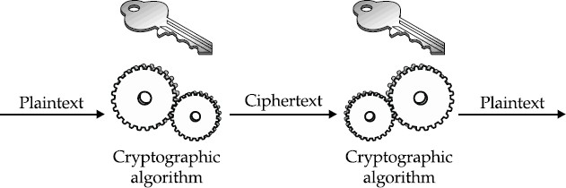
7.3 Control Methods of Database Security
Private Key Cryptography

Slide 43
7.3 Control Methods of Database Security
Public Key Cryptography
To remove the limitation of private key, the asymmetric or public key encryption method is come in existence in which a public key and a private key is used.
The private key is kept by the receiver and the public key is announced to the public by the same receiver to encrypt all the sending data for him by the general public or anyone.

Slide 44
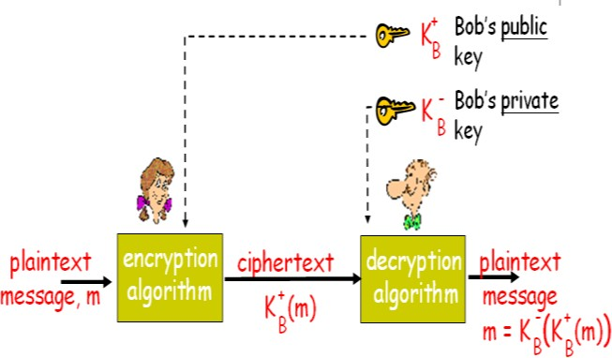
7.3 Control Methods of Database Security
Public Key Cryptography

Slide 45
Database Security
* Assignment
Backup and Recovery
Difference Between Encryption and Decryption
Private vs Public Cryptography
Challenges and Threats in Database Security

Slide 46
Crash Recovery

Slide 47
Crash Recovery
7.1 Crash Recovery
7.2 Failure Classification
7.3 Storage Structure
7.4 Recovery and Atomicity
7.5 Log Based Recovery
7.6 Checkpoints
7.7 Shadow paging
7.8 Data Backup / Recovery
7.7 Remote Backup System

Slide 48
7.1 Crash Recovery
DBMS is a highly complex system with hundreds of transactions being executed every second.
The durability and robustness of a DBMS depends on its complex architecture and its underlying hardware and system software.
If it fails or crashes amid transactions, it is expected that the system would follow some sort of algorithm or techniques to recover lost data.

Slide 49
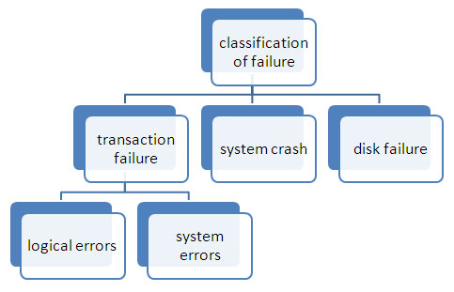
7.2 Failure classification

Slide 50
7.2 Failure classification
1) Transaction Failure
a. The transaction cannot continue because of internal conditions like data mismatch, overflow etc. this is logical error.
b. The transaction cannot continue as the system enter into an undesirable state like deadlock , this is system error
2) System crash
a. It is the failure caused due to hardware malfunctioning or software bugs that do not affect data of nonvolatile storage.

Slide 51
7.2 Failure classification
3) Disk failure
a. It is the failure caused due to head crash or data transfer failure.
b. Multiple backups are used to recover from this failure.

Slide 52
7.3 Storage Structure
Volatile storage −
As the name suggests, a volatile storage cannot survive system crashes.
Volatile storage devices are placed very close to the CPU; normally they are embedded onto the chipset itself.
For example, main memory and cache memory are examples of volatile storage.
They are fast but can store only a small amount of information.

Slide 53
7.3 Storage Structure
Non-volatile storage −
These memories are made to survive system crashes.
They are huge in data storage capacity, but slower in accessibility.
Examples may include hard-disks, magnetic tapes, flash memory, and non-volatile (battery backed up) RAM.

Slide 54
7.3 Storage Structure
Stable Memory -
This is said to be third form of memory structure but it is same as non volatile memory.
In this case, copies of same non volatile memories are stored at different places.
This is because, in case of any crash and data loss, data can be recovered from other copies.
This is even helpful if there one of non-volatile memory is lost due to fire or flood.
It can be recovered from other network location.

Slide 55
7.4 Recovery and Atomicity
When a system crashes, it may have several transactions being executed and various files opened for them to modify the data items.
Transactions are made of various operations, which are atomic in nature.
But according to ACID properties of DBMS, atomicity of transactions as a whole must be maintained, that is, either all the operations are executed or none.

Slide 56
7.4 Recovery and Atomicity
When a DBMS recovers from a crash, it should maintain the following :
It should check the states of all the transactions, which were being executed.
A transaction may be in the middle of some operation; the DBMS must ensure the atomicity of the transaction in this case.
It should check whether the transaction can be completed now or it needs to be rolled back.
No transactions would be allowed to leave the DBMS in an inconsistent state.

Slide 57
7.4 Recovery and Atomicity
There are two types of techniques, which can help a DBMS in recovering as well as maintaining the atomicity of a transaction −
Maintaining the logs of each transaction, and writing them onto some stable storage before actually modifying the database.
Maintaining shadow paging, where the changes are done on a volatile memory, and later, the actual database is updated.

Slide 58
7.5 Recovery Algorithm using Log Based Recovery
Log is a sequence of records, which maintains the records of actions performed by a transaction.
It is important that the logs are written prior to the actual modification and stored on a stable storage media, which is failsafe.

Slide 59
7.5 Recovery Algorithm using Log Based Recovery
Log-based recovery works as follows −
The log file is kept on a stable storage media.
When a transaction enters the system and starts execution, it writes a log about it.
<Tn, Start>
When the transaction modifies an item X, it write logs as follows −
<Tn, X, V1, V2>
It reads Tn has changed the value of X, from V1 to V2.
When the transaction finishes, it logs −
<Tn, commit>

Slide 60
7.5 Recovery Algorithm using Log Based Recovery
When the system is crashed, then the system consults the log to find which transactions need to be undone and which need to be redone.
If the log contains the record <Ti, Start> and <Ti, Commit> or <Ti, Commit>, then the Transaction Ti needs to be redone.
If log contains record<Tn, Start> but does not contain the record either <Ti, commit> or <Ti, abort>, then the Transaction Ti needs to be undone.

Slide 61
7.5 Recovery Algorithm using Log Based Recovery
The database can be modified using two approaches −
Deferred database modification − All logs are written on to the stable storage and the database is updated when a transaction commits.
Immediate database modification − Each log follows an actual database modification. That is, the database is modified immediately after every operation.

Slide 62
7.5 Recovery Algorithm using Log Based Recovery
Deferred database modification −
It is also called NO-UNDO/REDO technique.
It is used for the recovery of the transaction failures which occur due to power, memory or OS failures.
Whenever any transaction is executed, the updates are not made immediately to the database.
Only new Values are stored in log.

Slide 63
7.5 Recovery Algorithm using Log Based Recovery
Deferred database modification −
They are first recorded on the log file and then those changes are applied once commit is done.
This is called “Re-doing” process. Once the rollback is done none of the changes are applied to the database and the changes in the log file are also discarded.
If commit is done before crashing of the system, then after restarting of the system the changes that have been recorded in the log file are thus applied to the database.

Slide 64
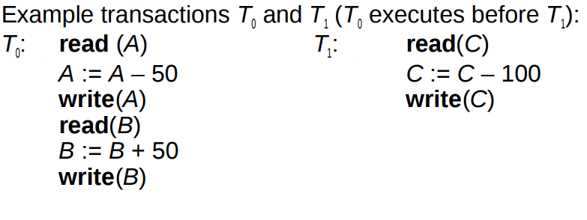
7.5 Recovery Algorithm using Log Based Recovery
Deferred database modification −Example

Slide 65
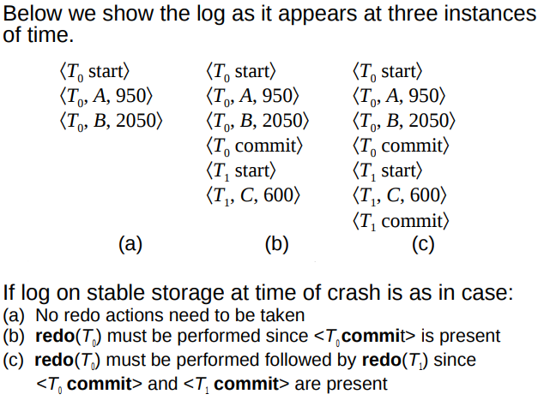
7.5 Recovery Algorithm using Log Based Recovery
Deferred database modification −Example

Slide 66
7.5 Recovery Algorithm using Log Based Recovery
Immediate database modification −
It is also called UNDO/REDO technique.
It is used for the recovery of the transaction failures which occur due to power, memory or OS failures.
Whenever any transaction is executed, the updates are made directly to the database and the log file is also maintained which contains both old and new values.
Once commit is done, all the changes get stored permanently into the database and records in log file are thus discarded.

Slide 67
7.5 Recovery Algorithm using Log Based Recovery
Immediate database modification −
Once rollback is done the old values get restored in the database and all the changes made to the database are also discarded.
This is called “Un-doing” process.
If commit is done before crashing of the system, then after restarting of the system the changes are stored permanently in the database.
Old and new values are stored in log.

Slide 68
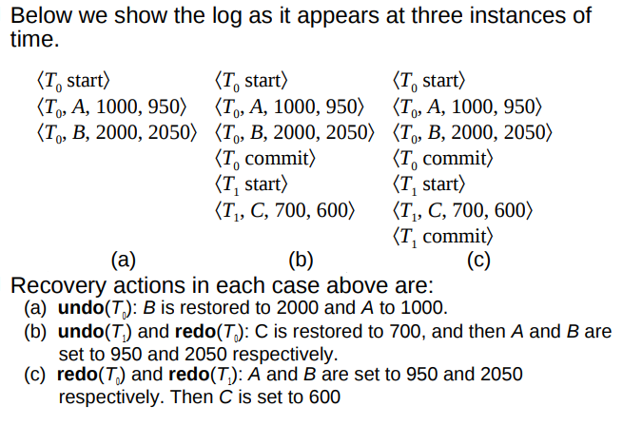
7.5 Recovery Algorithm using Log Based Recovery
Immediate database modification −Example

Slide 69
Assignment
Difference between deferred update and immediate update

Slide 70
7.6 Checkpoints
The checkpoint is a type of mechanism where all the previous logs are removed from the system and permanently stored in the storage disk.
The checkpoint is like a bookmark. While the execution of the transaction, such checkpoints are marked, and the transaction is executed then using the steps of the transaction, the log files will be created.
When it reaches to the checkpoint, then the transaction will be updated into the database, and till that point, the entire log file will be removed from the file. Then the log file is updated with the new step of transaction till next checkpoint and so on.
The checkpoint is used to declare a point before which the DBMS was in the consistent state, and all transactions were committed.

Slide 71
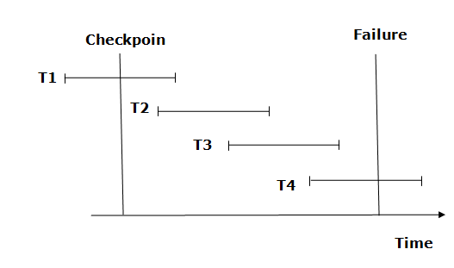
7.6.1 Recovery using Checkpoints
The recovery system reads log files from the end to start. It reads log files from T4 to T1.
Recovery system maintains two lists, a redo-list, and an undo-list.

Slide 72
7.6.1 Recovery using Checkpoints
The transaction is put into redo state if the recovery system sees a log with <Tn, Start> and <Tn, Commit> or just <Tn, Commit>. In the redo-list and their previous list, all the transactions are removed and then redone before saving their logs.
For example: In the log file, transaction T2 and T3 will have <Tn, Start> and <Tn, Commit>. The T1 transaction will have only <Tn, commit> in the log file. That's why the transaction is committed after the checkpoint is crossed. Hence it puts T1, T2 and T3 transaction into redo list.

Slide 73
7.6.1 Recovery using Checkpoints
The transaction is put into undo state if the recovery system sees a log with <Tn, Start> but no commit or abort log found. In the undo-list, all the transactions are undone, and their logs are removed.
For example: Transaction T4 will have <Tn, Start>. So T4 will be put into undo list since this transaction is not yet complete and failed amid.

Slide 74
7.7 Shadow Paging
Shadow Paging is recovery technique that is used to recover database.
In this recovery technique, database is considered as made up of fixed size of logical units of storage which are referred as pages.
pages are mapped into physical blocks of storage, with help of the page table which allow one entry for each logical page of database.
This method uses two page tables named current page table and shadow page table.

Slide 75
7.7 Shadow Paging
The entries which are present in current page table are used to point to most recent database pages on disk.
Another table i.e., Shadow page table is used when the transaction starts which is copying current page table.
After this, shadow page table gets saved on disk and current page table is going to be used for transaction.
Entries present in current page table may be changed during execution but in shadow page table it never get changed.
After transaction, both tables become identical.

Slide 76
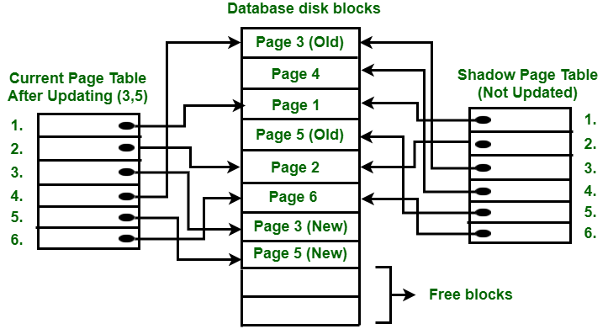
7.7.1 Working of Shadow Paging
This technique is also known as Cut-of-Place updating.

Slide 77
7.7.1 Working of Shadow Paging
All the read and write transactions are performed on the shadow copy of the database.
When the transactions get completed, then the results will be updated to the database.
If any transaction fails during the execution it will not be updated in the database because read and write operations are firstly performed on the shadow copy of the database.
The database is only updated when the transaction is successfully completed.

Slide 78
7.7.2 Directories in Shadow Paging
Current Directory or Current page table
At the start of the transaction, both the directories (current and shadow) are identical and the current directory of a database is updated when the transaction performs a write operation.
The current directory is also called a current page table. The most recent pages of the database are stored in the current page table.
.

Slide 79
7.7.2 Directories in Shadow Paging
Shadow Directory or Shadow page table
In this technique, a copy of a database is created that is called a shadow directory.
The shadow directory is never changed during the execution of a transaction. It is also called the shadow page table.

Slide 80
Assignment
Advantages and Disadvantages of shadow paging

Slide 81
7.8 Data Backup / Recovery
Database Backup is storage of data that means the copy of the data.
It is a safeguard against unexpected data loss and application errors.
It protects the database against data loss.
If the original data is lost, then using the backup it can reconstructed.

Slide 82
7.8.1 Methods of Backup
Full Backup - This method takes a lot of time as the full copy of the database is made including the data and the transaction records.
Transaction Log - Only the transaction logs are saved as the backup in this method. To keep the backup file as small as possible, the previous transaction log details are deleted once a new backup record is made.
Differential Backup - This is similar to full backup in that it stores both the data and the transaction records. However only that information is saved in the backup that has changed since the last full backup. Because of this, differential backup leads to smaller files.

Slide 83
7.8.2 Database Recovery
Log based recovery - In log based recovery, logs of all database transactions are stored in a secure area so that in case of a system failure, the database can recover the data.
Shadow paging - In shadow paging, after the transaction is completed its data is automatically stored for safekeeping.

Slide 84
7.7 Remote Backup System
Remote backup provides a sense of security in case the primary location where the database is located gets destroyed.
Remote backup can be offline or real-time or online.
In case it is offline, it is maintained manually.

Slide 85
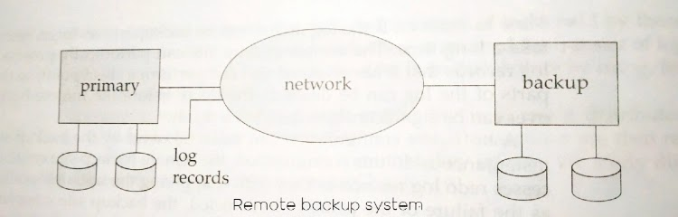
7.7 Remote Backup System

Slide 86
7.7 Remote Backup System
We can achieve high availability by performing transaction processing at one site, called the primary site, and having a remote backup site where all the data from the primary site are replicated.
The remote backup site is sometimes also called the secondary site.
The remote site must be kept synchronized with the primary site, as updates are performed at the primary.

Slide 87
7.7 Remote Backup System
We achieve synchronization by sending all log records from primary site to the remote backup site.
The remote backup site must be physically separated from the primary.
for example, we can locate it in a different state—so that a disaster at the primary does not damage the remote backup site.

Slide 88
7.7 Remote Backup System
Availability is greatly increased over a single-site system, since the system can recover even if all data at the primary site are lost. The performance of a remote backup system is better than the performance of a distributed system with two-phase commit.

Slide 89
Assignment
Advantages and Disadvantages of Remote Backup System

Slide 90
This is the end of the lecture!
I hope you enjoyed it.
Thank You

